Slide 1
Implementing VLANs in Campus Networks
Configuring Link Aggregation with EtherChannel

Slide 2
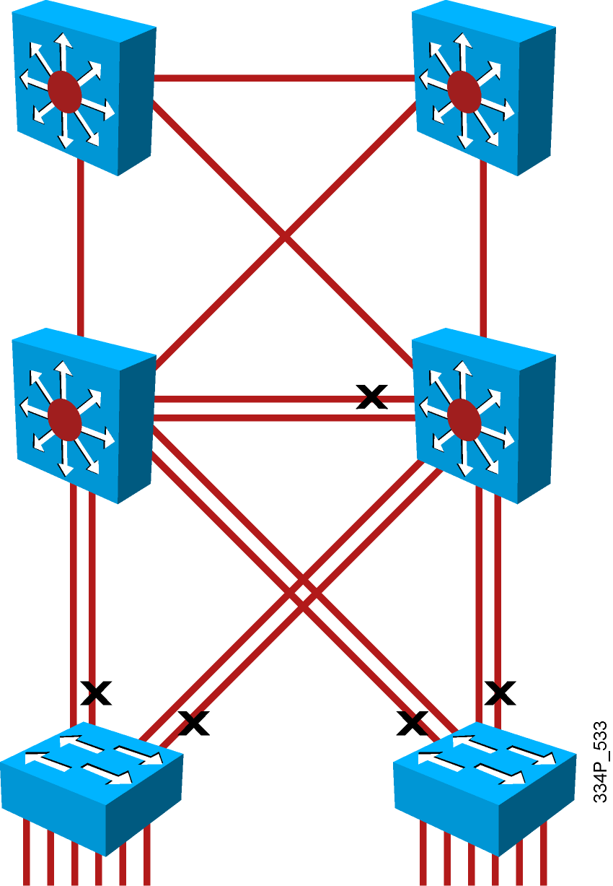
Multiple Links
  When multiple links aggregate on a switch, congestion occurs.
  One solution is to increase uplink speed, but cannot scale indefinitely.
  Another solution is to multiply uplinks; loop prevention mechanisms disable some ports.

Slide 3
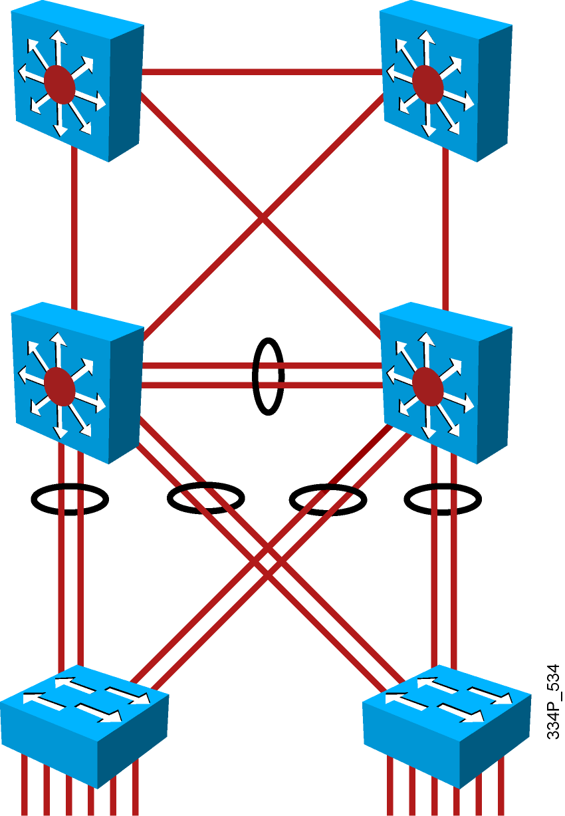
EtherChannel
  Solution to provide more bandwidth
  Logical aggregation of similar links
  Viewed as one logical link
  Provides load balancing and redundancy
  Supported for switch ports (Layer 2) and routed ports (Layer 3)

Slide 4
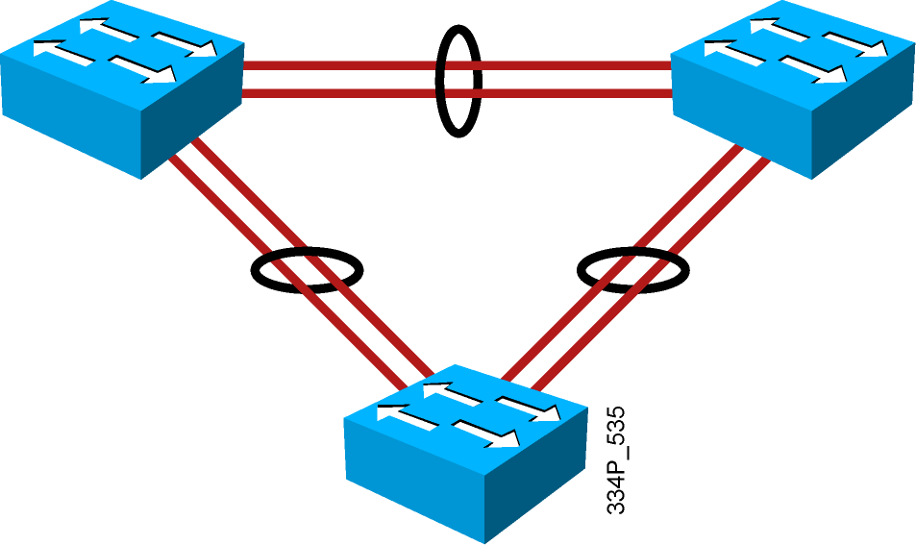
PAgP and LACP
  Protocols to negotiate the EtherChannel link creation and maintenance.
  PAgP is a Cisco proprietary protocol.
  LACP is IEEE 802.3ad standard.
  Static EtherChannel configuration without protocol.

Slide 5
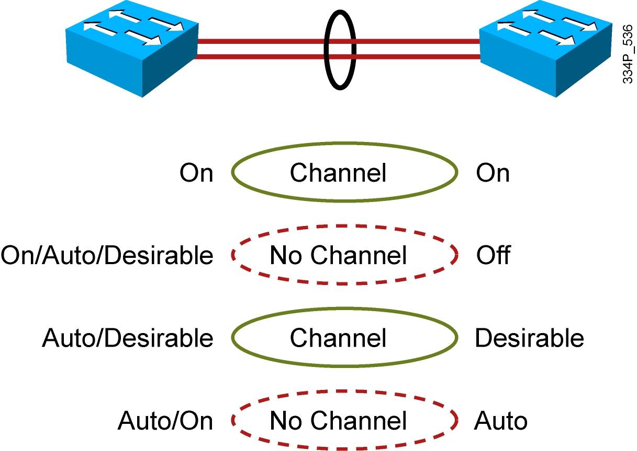
PAgP Modes
PAgP negotiates EtherChannel formation and maintenance:
  On: channel member without negotiation (no protocol)
  Desirable: actively ask if the other side can/will
  Auto: passively wait for other side to ask
  Off: EtherChannel not configured on interface

Slide 6
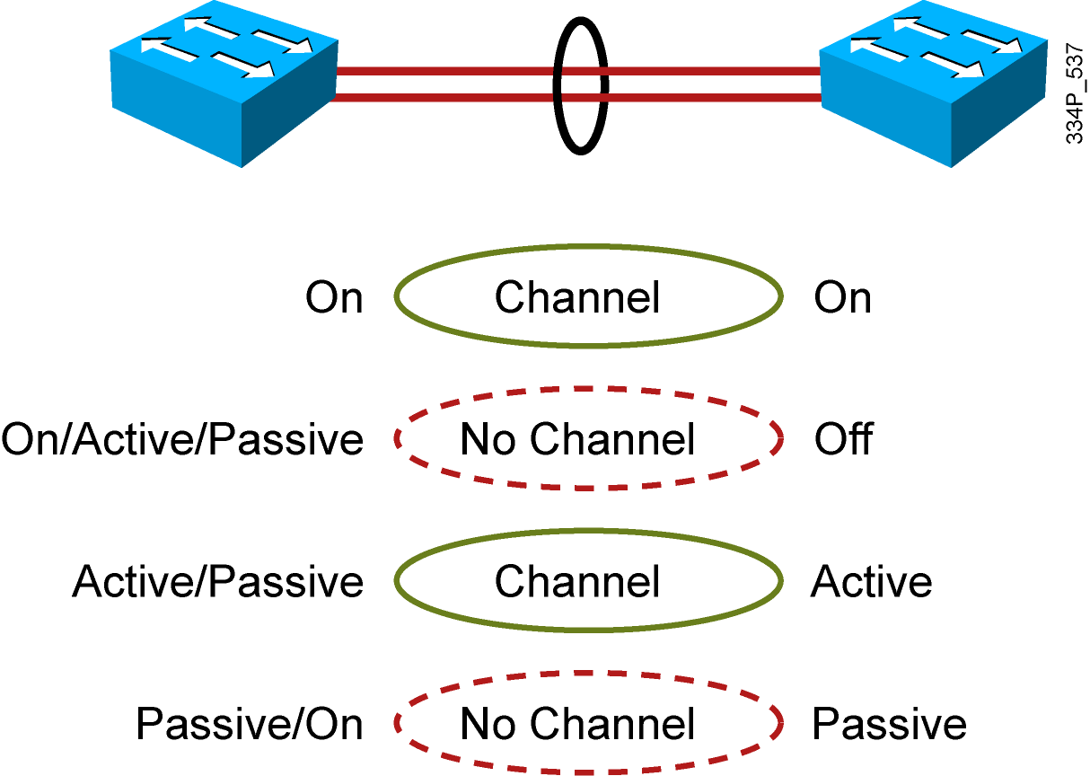
LACP Modes
LACP negotiates EtherChannel formation and maintenance:
  On: channel member without negotiation (no protocol)
  Active: actively ask if the other side can/will
  Passive: passively wait for other side to ask
  Off: EtherChannel not configured on interface

Slide 7
How to Configure Port Channels Using EtherChannel
Basic tasks:
  Identify the ports to use on each switch.
  Specify PAgP or LACP protocol (optional).
  Configure channel group on interface.
    Specify a channel group number.
    Specify the mode (will set protocol).
      On (no protocol)
      Auto/desirable (PAgP)
      Active/passive (LACP)
  Configure port-channel interface.
    Access or trunk mode and other parameters.
  Verify connectivity.

Slide 8
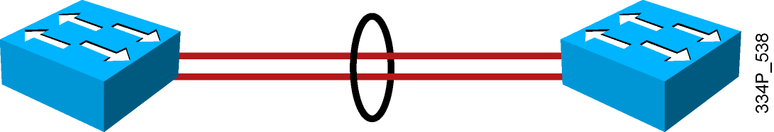
Guidelines for Configuring EtherChannel
Port-channel interface configuration changes affect the EtherChannel.
The physical interface configuration changes affect the interface only.
EtherChannel cannot be used if SPAN is a destination port.
All interfaces within an EtherChannel must have same configuration.
  Same speed and duplex.
  Same mode (access or trunk).
  Same native and allowed VLANs on trunk ports.
  Same access VLAN on access ports.
  Configure these parameters on the port-channel interface.

Slide 9
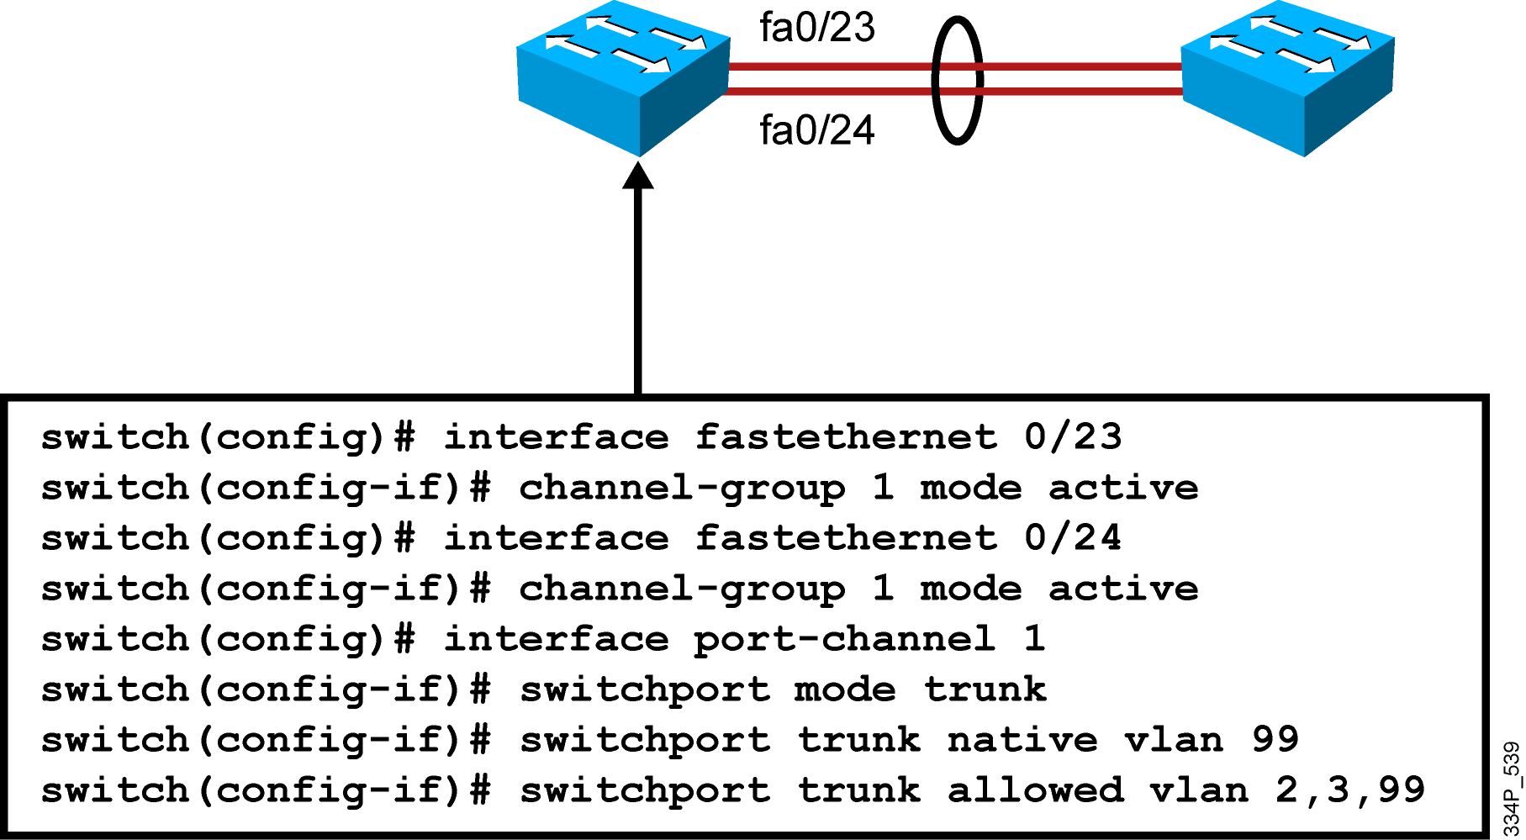
How to Configure Layer 2 EtherChannel
  Channel group mode options:
    On
    Active or passive (LACP)
    Auto or desirable (PAgP)
  The configuration on a port-channel interface is copied to member interfaces.

Slide 10
How to Verify EtherChannel
Switch#show interfaces f0/24 etherchannel
Port state = Up Sngl-port-Bndl Mstr Not-in-Bndl
Channel group = 1 Mode = Active Gcchange = -
Port-channel = null GC = - Pseudo port-channel = Po1
Port index = 0 Load = 0x00 Protocol = LACP
Switch#show etherchannel 1 port-channel
Port-channels in the group:
---------------------------
Port-channel: Po1 (Primary Aggregator)
Age of the Port-channel = 195d:03h:10m:44s
Logical slot/port = 0/1 Number of ports = 2
Port state = Port-channel Ag-Inuse
Protocol = LACP
Ports in the Port-channel:
Index Load Port EC state No of bits
------+------+------+------------------+-----------
0 55 fa0/23 Active 4
1 45 fa0/24 Active 4

Slide 11
How to Verify EtherChannel (Cont.)
switch# show etherchannel summary
Flags: D - down P - bundled in port-channel
I - stand-alone s - suspended
H - Hot-standby (LACP only)
R - Layer3 S - Layer2
U - in use f - failed to allocate aggregator
M - not in use, minimum links not met
u - unsuitable for bundling
w - waiting to be aggregated
d - default port
Number of channel-groups in use: 1
Number of aggregators: 1
Group Port-channel Protocol Ports
------+-------------+-----------+-----------------------------------
2 Po1(SU) - Fa0/23(P) Fa0/24(P)

Slide 12
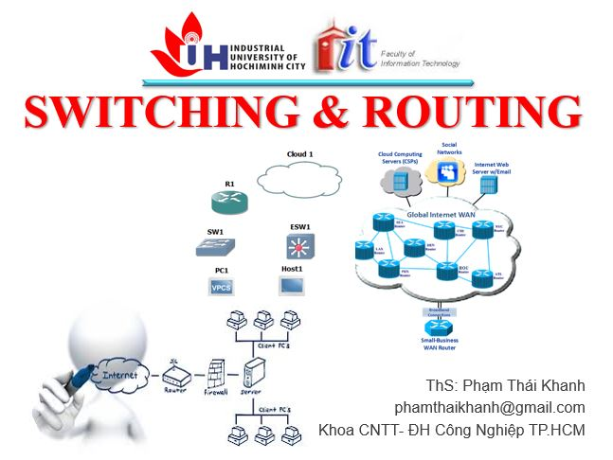


phamthaikhanh@gmail.com
This Photo by Unknown Author is licensed under CC BY-NC

